Slide 1
The R Slideshow Ecosystem
Myfanwy Johnston
Davis R-Users Group
June 6, 2016

Slide 2
Overview
Definitions
Schematics
Options
Rpres
Slidify
slidifyExamples
build a slidify
Motivations

Slide 3
All R Slideshows are created using some combination of Rmarkdown + HTML + other markup or lightweight markup languages.
Markup language
“A notation used to annotate a document’s content to give information regarding the structure of the text or instructions for how it is to be displayed”
Examples: HTML, LaTeX, Markdown
Lightweight markup language
“largely unstandardized language that’s been developed to allow authors to create formatted text via web browsers, for use in wikis and web forums”
Examples: Rmarkdown, Github Flavored Markdown
pandoc
the swiss-army knife of converting files from one markup language to another

Slide 4
The basic components of an R slideshow is then a framework + a theme + a highlighter + widgets/extensions
Framework
“A collection of stylesheets, javascripts, and layouts that control the style and appearance of a slide deck”
Examples: reveal.js, slidy, beamer
Theme
“A collection of stylesheets that provides different skins for slide decks generated using the slide deck framework.”
Examples: reveal.js::solarized

Slide 5
Schematic of an R Slideshow
Slidify presentation
author(‘mydeck’)
Framework
revealjs, ioslides
Theme
solarized
layout customizations
write your own!
Syntax highlighter
hghlight.js
highlighter theme
tomorrow
custom CSS
write your own!
widgets/extensions
mathjax, quiz

Slide 6
R Slideshow Ecosystem
Package/Program | Frameworks | Distinguishing Characteristics
Rpres | slidy, ioslides, reveal.js, beamer | baked in to RStudio
Slidify | slidy
 | ioslides
 | reveal.js, flowtime.js, fathomjs | nice transitions/navigations via javascript
 | HTML5Slides
 | shower
 | landslide
 | deck.js
 | slideous
 | dzslides

Slide 7
Slideshow Frameworks
Slidify
Rpres
HTML5 Slides
ImpressJS
html5rocks
deck.js
dzslides
landslide
shower
slideous
ioslides
slidy
reveal.js
beamer

Slide 8
Slideshow outputs
Package/Framework | Output
Slidify | HTML5
- slidy | XHTML
- ioslides | HTML
- reveal.js | HTML with JavaScript elements for transitions
Rpres | markdown (.md) file, Rmd file, output format file
- beamer | PDF

Slide 9
A Slideshow
Myfanwy Johnston

Slide 10
Things that go in a slideshow
Title Slide with affiliation and logo
Outline Slide with incremental bullets
Intro slide with a picture
Methods slide with a diagram
Results slide with a graph

Slide 11
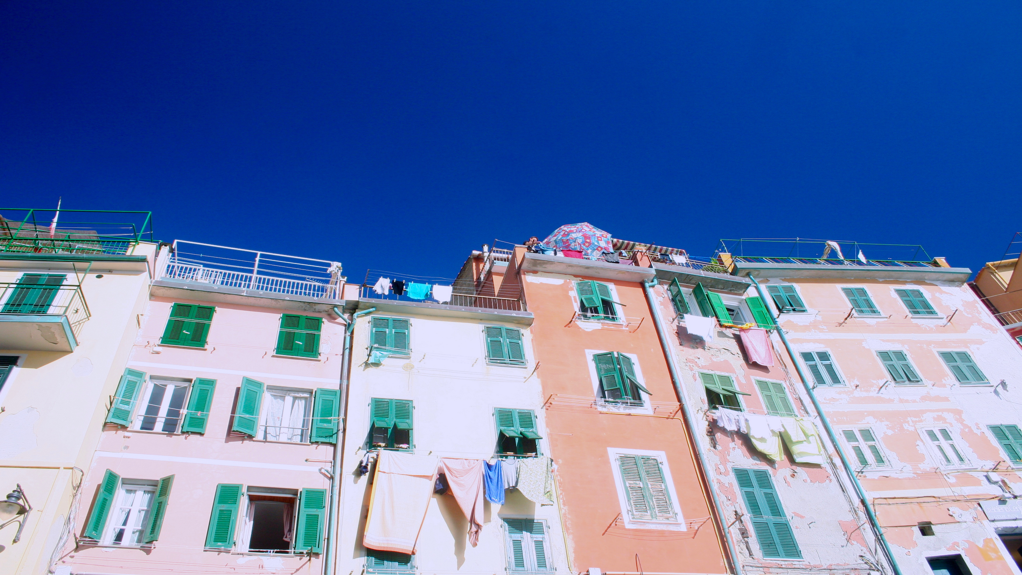
Intro slide with a horizontal picture

Slide 12
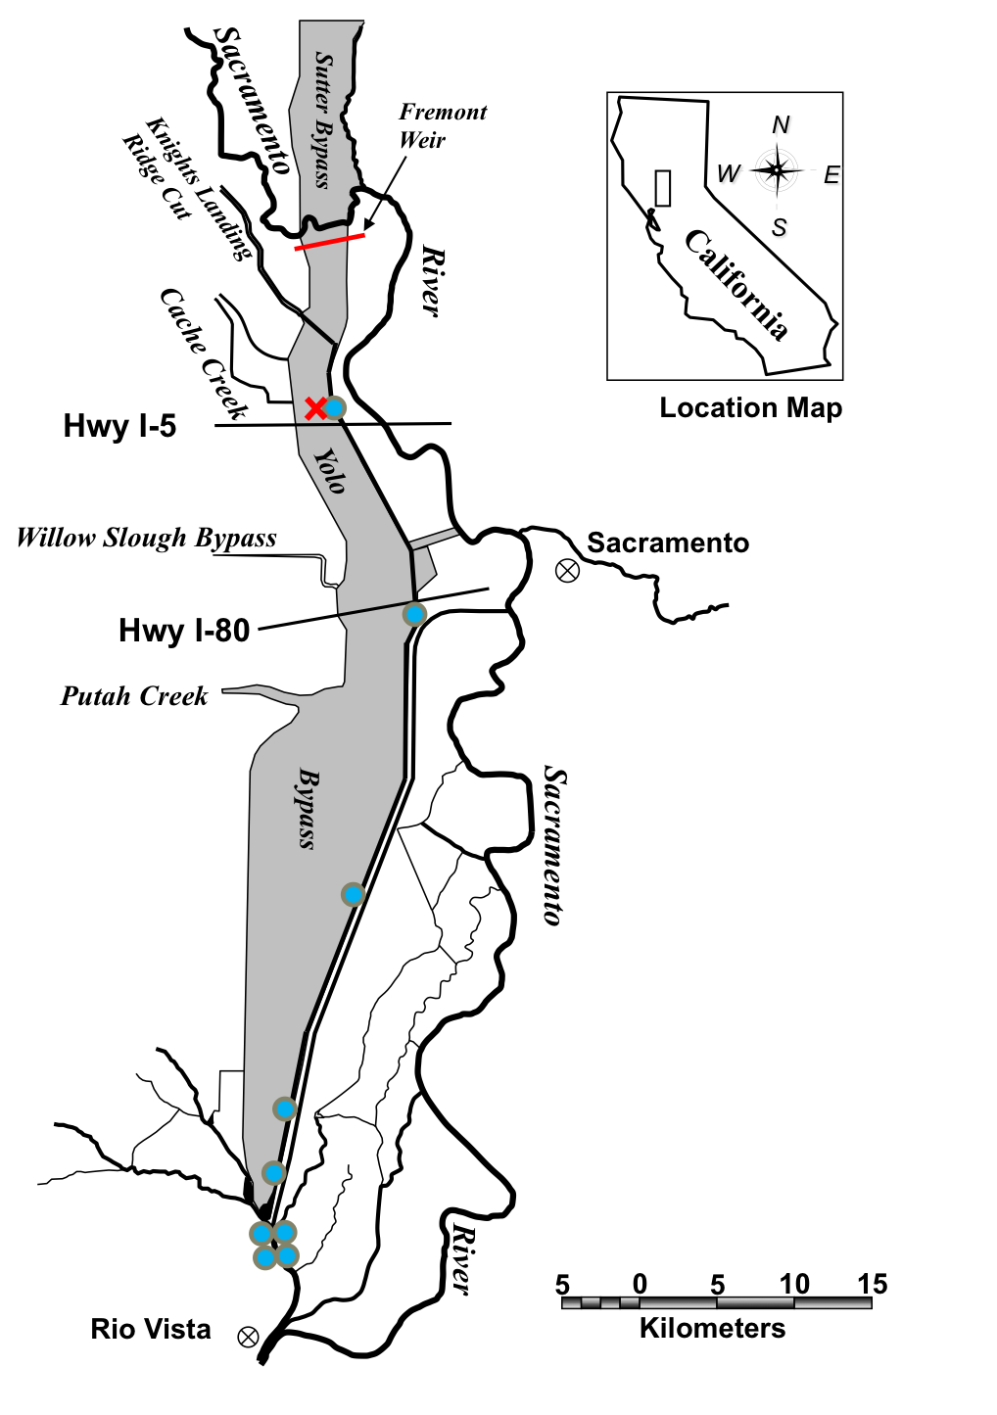
Methods slide with a vertical diagram
Acoustic telemetry array in the Yolo Bypass

Slide 13
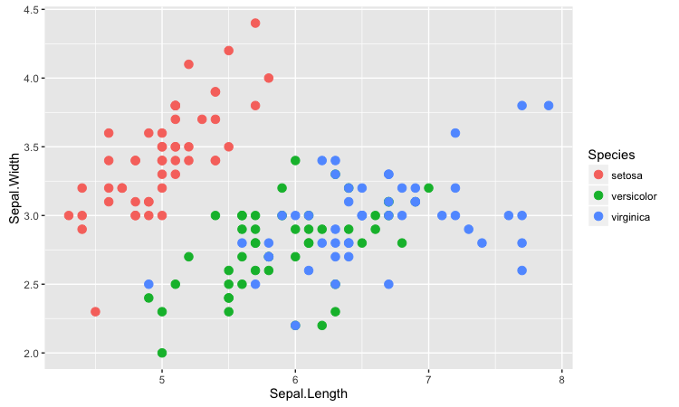
Results

Slide 14
Motivation for R Presentations
Pros
Cons
Reproducible
interactivity
R CODE
figures are a pain
layouts are a pain
creativity is a pain

